Slide 1

The development of news sentiment detection meta-model for sensitive content detection in Russian news feeds
Executor: Udalov Egor Vladimirovich, J4234c Scientific advisor: Kraev Semyon Vladimirovich Scientific Consultants: Laushkina Anastasia Alexandrovna
Samigulin Timur

Slide 2

Problem & Relevance
PROBLEM: there is a turbulence in economics, politics and social fields, so that some news feeds contain sensitive content for people
RELEVANCE:
1) Emotional and physical health has deteriorated for 53% of Russians in 2022, according to analysts at McKinsey.
2) Overall, the situation in Russia has deteriorated over 2022 rather than remaining the same according to a Levada Centre survey
3) Russian news media are the most trusted by the population in Russia (53%), according to the latest VСIOM survey in 2023
2

Slide 3

Object & Subject
Object: textual news from news feeds
Subject: emotional reaction of newsreaders to textual news from news feeds
3

Slide 4
Hypothesis & Novelty
Hypothesis: if to combine recent techniques of building a meta model on the top of embedding model, the quality of the resulting model might be higher
Novelty: first sensitive content detection model in Russian news feeds, that utilizes stacking model
4

Slide 5
Goal & Tasks
GOAL: to develop sensitive news detection meta model by combining recent techniques to build a meta (hybrid) model on the top of embedding model to detect sentiments in a text
SOLVED TASKS:
State a general configuration of the meta model
Evaluate considered configurations of the meta model
Find the best configuration of the meta model
5

Slide 6
I. Dataset review
Number of observations | 4388709
Number of labels | 2
Text column description | News title
Labels’ description | - 0: Sensitive news title - 1: Non-sensitive news title
Labels rate, % | - 0: 31 % - 1: 69 %
Min / Max / Mean number of words in a text | 1 / 32 / 16
Language rate, % | Russian: 97.7 % English: 1.4 %
Table.
Summary of collected data
6

Slide 7
II. Summary of articles’ review
The following conclusions have been made as a result of review:
- better to consider pre-trained LLM as an embedding model when encoding text data
- convolution-based models can be applied to extract higher levels of both spatial and temporal features from the text
- recurrent models can be applied to extract an overall information about the text
- multi-head self-attention model can be applied to refocus embeddings, so that it will be easier to extract important features
- classic classification models (like LR, SVM) can be applied to the logits for further potential improvement of the quality of predictions
7

Slide 8
III. Evaluation Metrics
Main metric: F1
- meta model is supposed to be good at detecting sensitive content to help sensitive people avoid being stressed and anxious, while being able to not miss-predict that a non-sensitive content is sensitive
- f1 metric is a trade-off between being good at detecting all items of one class and not making false predictions
Secondary metric: accuracy
- it is commonly used metric in the most of similar problems
8

Slide 9
IV. Meta Model Configuration
1-level models:
- Head model configuration is the same of all head models
- For each of three head models a recurrent model (RM) must be selected
2-level model:
- One of classification models must be selected
Encoding layer
1-Level Models
2-Level Model
Head Model 1 (RNN / BiRNN)
Embedding Model (LLM)
Stacking Model
Head Model 2 (LSTM / BiLSTM)
Head Model 3 (GRU / BiGRU)
Figure. Meta model configuration
9

Slide 10
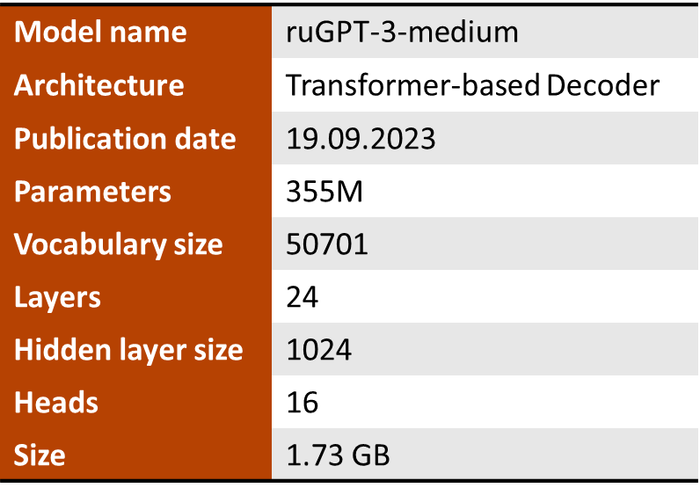
V. Embedding Model
Embedding model selection criteria:
- Must be good at both Russian and English
- Must be of not a big size (due to hardware limitations)
Table. Selected embedding model
10

Slide 11
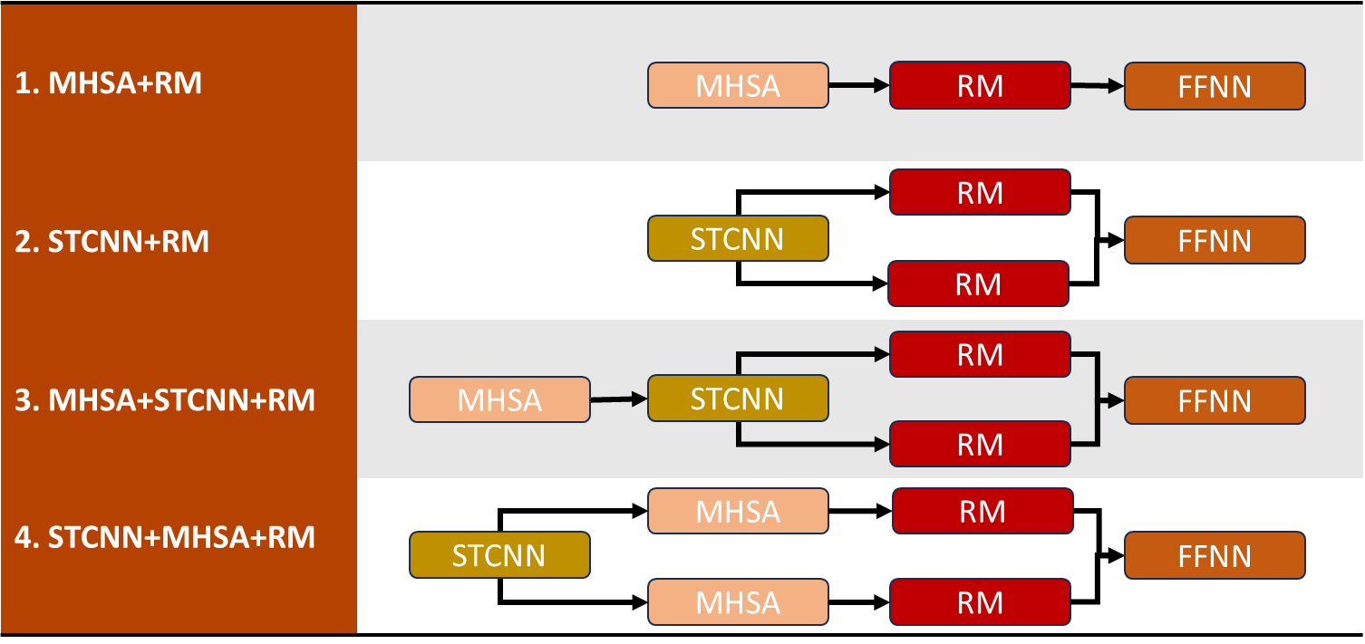
VI. Head Model
FFNN – feed forward neural network
RM – recurrent model
STCNN – spatial-temporal convolutional neural network
MHSA – multi-head self-attention
Table. Considered head model configurations
11

Slide 12
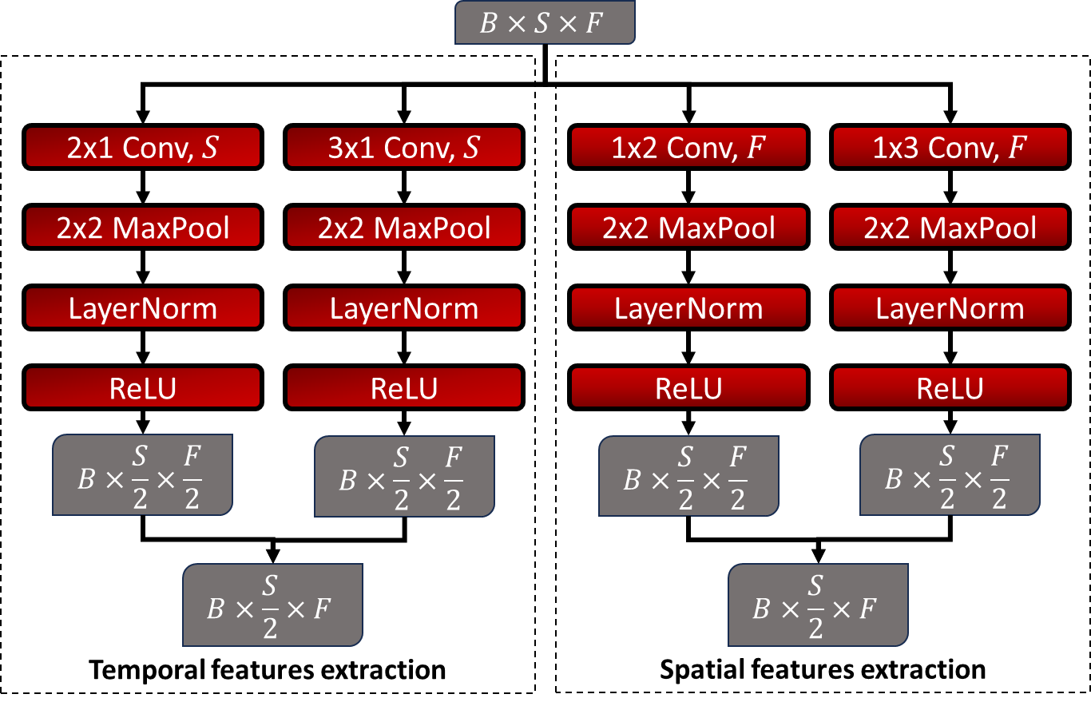
VI. Head Model
B – batch size
S – sequence length
F – embedding size
Figure. STCNN structure
12

Slide 13
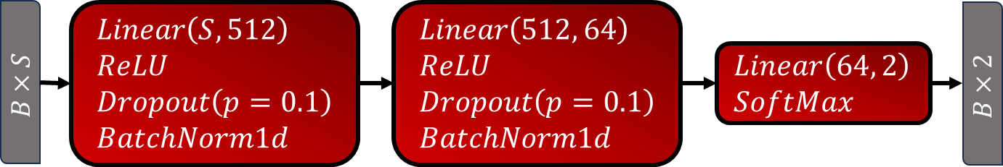
VI. Head Model
RM configuration:
- hidden size: 1024
- number of layers: 1
MHSA configuration:
- number of heads: 2
Figure. FFNN structure
Simplification: structure of each sub-model is fixed (it would take significant amount of time to tune all different variants of each head model)
13

Slide 14
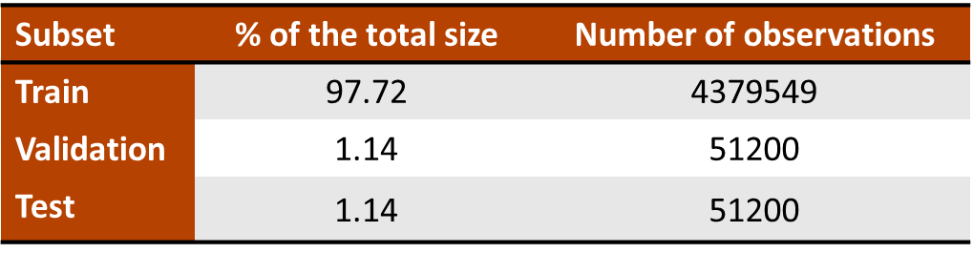
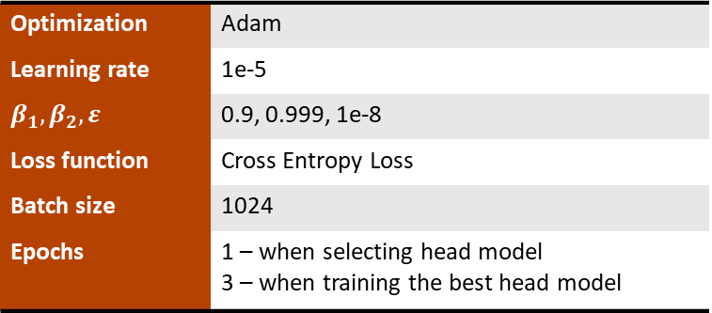
VI. Head Model
Simplification: Training process of head models is fixed
Optimization | Adam
Learning rate | 1e-5
$$β_{1},β_{2},ε$$ | 0.9, 0.999, 1e-8
Loss function | Cross Entropy Loss
Batch size | 1024
Epochs | 1 – when selecting head model 3 – when training the best head model
Table. Training process configuration
Table. Train-validation-test split
14

Slide 15
VII. Stacking Model
Training process:
- second-level model is trained on first-level logits generated by first-level models via
cross-validation on 4 folds
- second-level model is tuned using Optuna package (sampler – TPESampler) with
cross-validation on 4 folds
LR | SVC (linear) | SVC (rbf)
RFC | XGBoost | LightGBM
Table. List of considered second-level models
15

Slide 16
VIII. Head Model Selection Results
RM | F1 (validation) MHSA / STCNN / MHSA+STCNN / STCNN+MHSA | Accuracy (validation) MHSA / STCNN / MHSA+STCNN / STCNN+MHSA
FFNN | 0.7576 | 0.8509
RNN | 0.7946 / 0.7889 / 0.8028 / 0.7866 | 0.8761 / 0.8684 / 0.8806 / 0.8693
LSTM | 0.7976 / 0.7946 / 0.8026 / 0.7890 | 0.8779 / 0.8757 / 0.8791 / 0.8686
GRU | 0.7979 / 0.7907 / 0.8046 / 0.7838 | 0.8780 / 0.8725 / 0.8804 / 0.8658
BiRNN | 0.7993 / 0.7917 / 0.8037 / 0.7779 | 0.8777 / 0.8709 / 0.8813 / 0.8624
BiLSTM | 0.8016 / 0.7946 / 0.8048 / 0.7866 | 0.8774 / 0.8746 / 0.8807 / 0.8691
BiGRU | 0.8003 / 0.7908 / 0.8016 / 0.7840 | 0.8782 / 0.8718 / 0.8789 / 0.8687
Table. Evaluation results for head models. The best score for selected metric and RM is in bold (second best is underlined). The best overall score for selected metric is underlined and in bold
Best head model configuration: MHSA + STCNN + RM
Three selected configurations: MHSA + STCNN + BiRNN (BiLSTM, GRU)
16

Slide 17
IX. Stacking Model Selection Results
Model Type | Model | F1 (cross-validation) | F1 (test) | Accuracy (test)
Head Model | MHSA+STCNN+BiRNN | 0.8109 | 0.8547 | 0.9006
 | MHSA+STCNN+BiLSTM | 0.8188 | 0.8515 | 0.9001
 | MHSA+STCNN+GRU | 0.8134 | 0.8507 | 0.9005
Stacking Model | LR | 0.8199 | 0.8558 | 0.9036
 | SVC (linear) | 0.8206 | 0.8568 | 0.9039
 | SVC (rbf) * | 0.8240 | 0.4910 | 0.3428
 | RFC | 0.8231 | 0.8585 | 0.9029
 | XGBoost | 0.8233 | 0.8584 | 0.9030
 | LightGBM | 0.8237 | 0.8586 | 0.9029
Table. Evaluation results for selected head models and considered stacking models. The best score for selected metric is in bold, second best is underlined (* this model has overfitted)
Best second-level model: LightGBM
17

Slide 18
X. The Best Meta Model Configuration
Encoding layer
1-Level Models
2-Level Model
Embedding Model
(ruGPT3-medium)
HM1: MHSA+STCNN+BiRNN
LightGBM
HM2: MHSA+STCNN+BiLSTM
HM3: MHSA+STCNN+GRU
Figure. The best meta model configuration
18

Slide 19
CONCLUSIONS
Practice results:
A general configuration of the meta model has been proposed
Considered configuration of the meta model has been evaluated
The best configuration of the meta model has been found
Future tasks:
Validate the best meta model on benchmarks datasets
Compare the best meta model with other state-of-the-art models on used dataset
Source code: https://github.com/GitHub-User228/RussianNewsSentimentAnalysis
19

Slide 20

THANK YOU FOR YOUR TIME!
egor.udalov13@gmail.com

